Slide 1
Mobile-Commerce Development
Lesson
Web Services
Lecturer:
Tran Duy Thanh, Phd
Nguyen Quang Phuc, Msc
Email: thanhtd@uel.edu.vn
Blog: https://tranduythanh.com
Phone: 0987773061

Slide 2
Lesson Objective
Students understand Web Service
Know some type of Web Services
Do the Restful API as well
Can do Postman, Swagger, GSon
Using Multi-threading with Restful API for Dong A Bank service

Slide 3
Outlines
Introducing Web Services
Restful API
Demo Multi-threading with DongA Bank Web Service

Slide 4
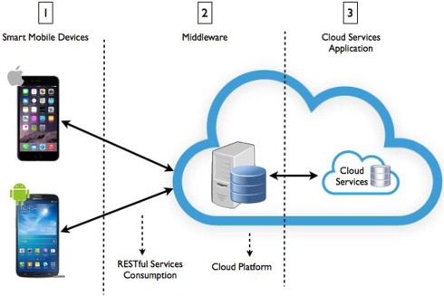
1. Introducing Web Services
Wikipedia:
A web service (WS) is either:
a service offered by an electronic device to another electronic device, communicating with each other via the Internet, or
a server running on a computer device, listening for requests at a particular port over a network, serving web documents (HTML, JSON, XML, images)
https://en.wikipedia.org/wiki/Web_service

Slide 5
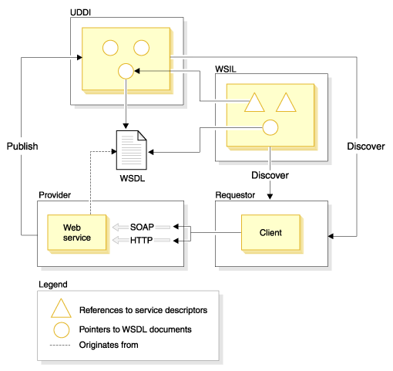
1. Introducing Web Services
Web services standards
Source: https://www.ibm.com/

Slide 6
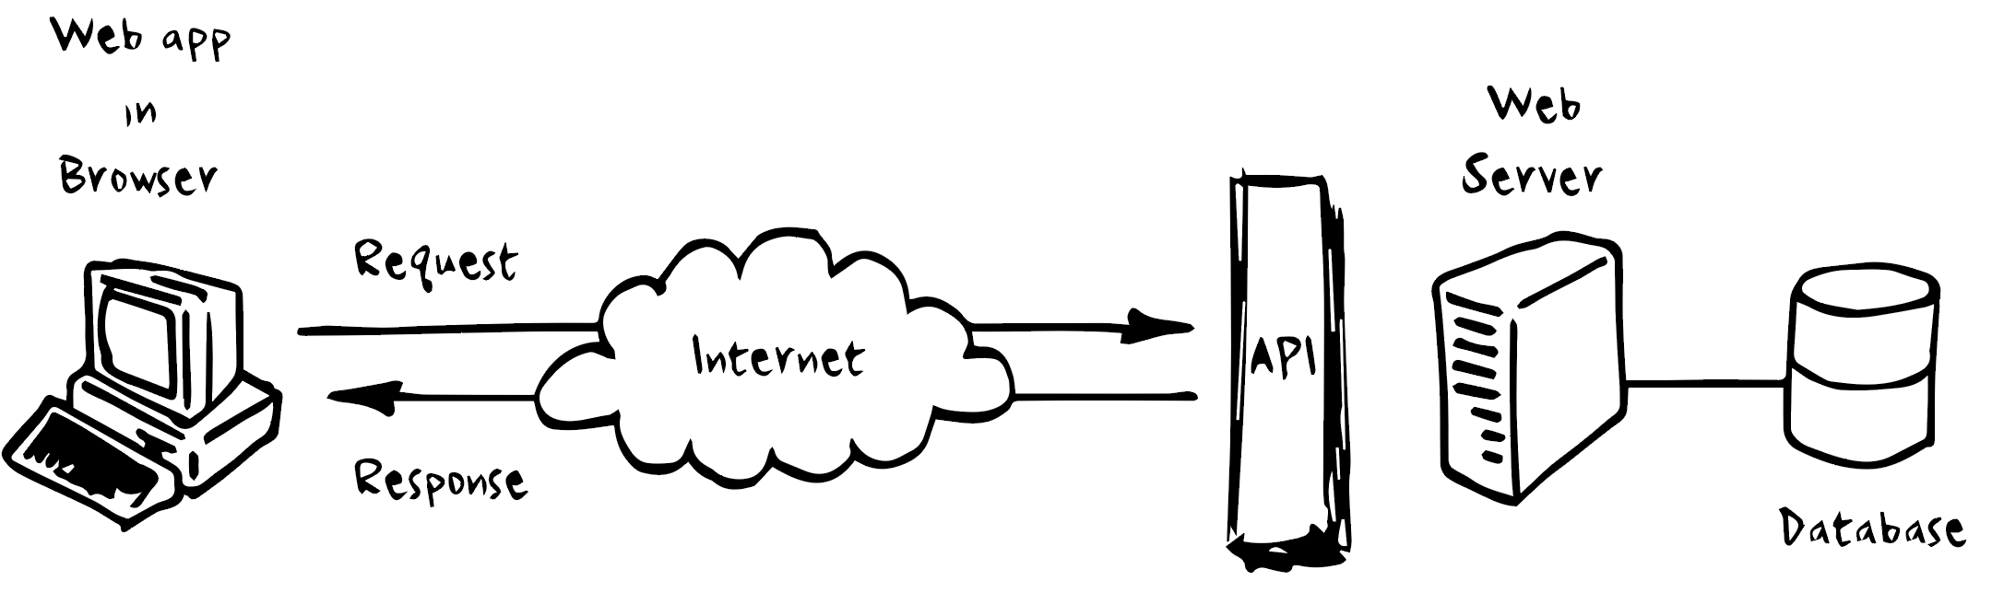
2. Restful API
An API (Application Programming Interface) is a set of rules and mechanisms that allow an application or component to interact with another application or component. The API can return the data needed by the application in common formats such as JSON or XML.

Slide 7
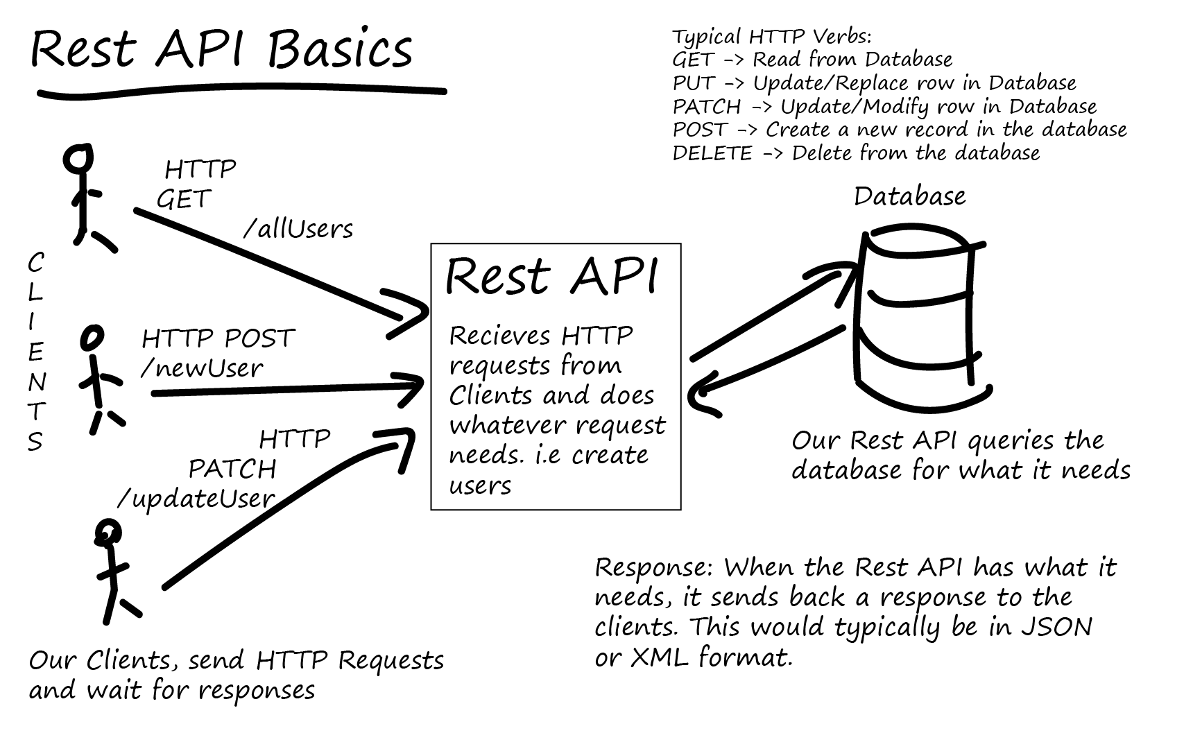
2. Restful API
Restful API is one of the popular standards used to design APIs for web applications to manage resources, helping different applications (web, mobile…) to communicate with each other. It usually includes preformatted resource states and is transmitted over HTTP.

Slide 8
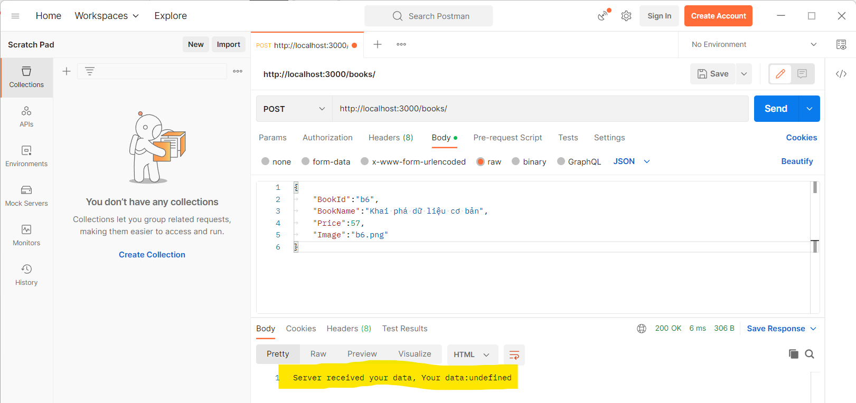
3. Integrating with DongA Bank
Install Postman, this tool is very convenient, it helps us to test the API before using it.
There is also the Swagger tool (https://swagger.io ).
In the content of this course we will use Postman. https://www.postman.com/downloads

Slide 9
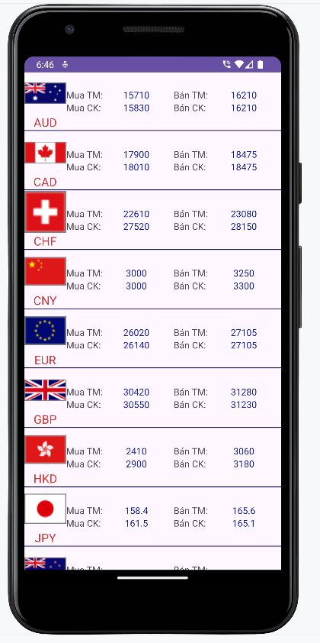
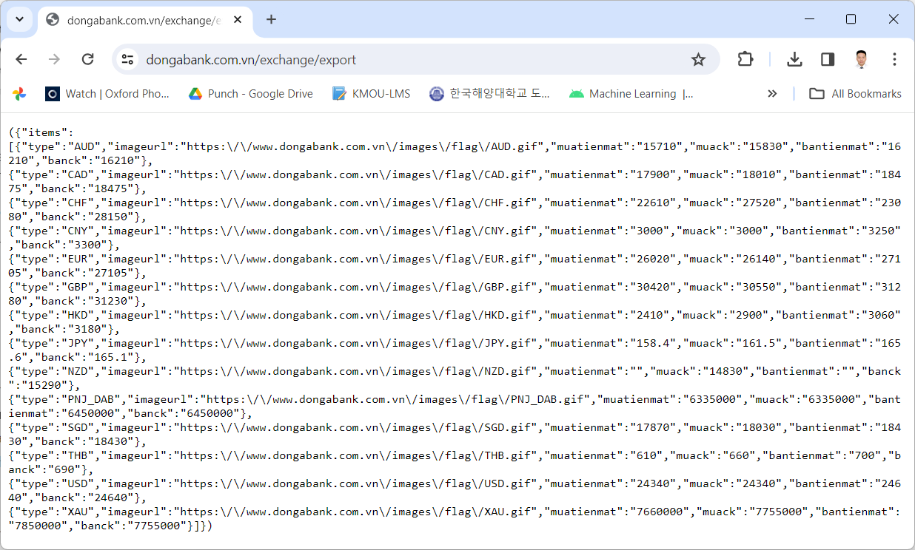
3. Integrating with DongA Bank
https://dongabank.com.vn/exchange/export

Slide 10
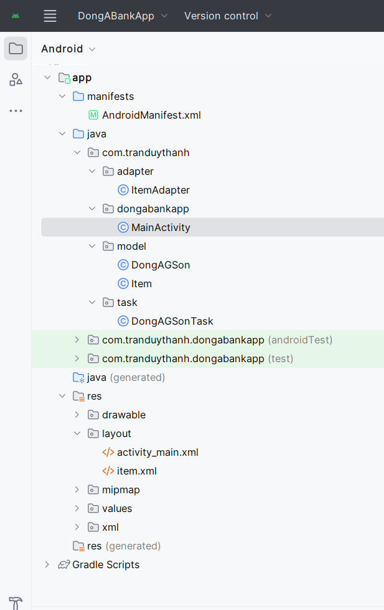
3. Integrating with DongA Bank
Create DongABankApp

Slide 11
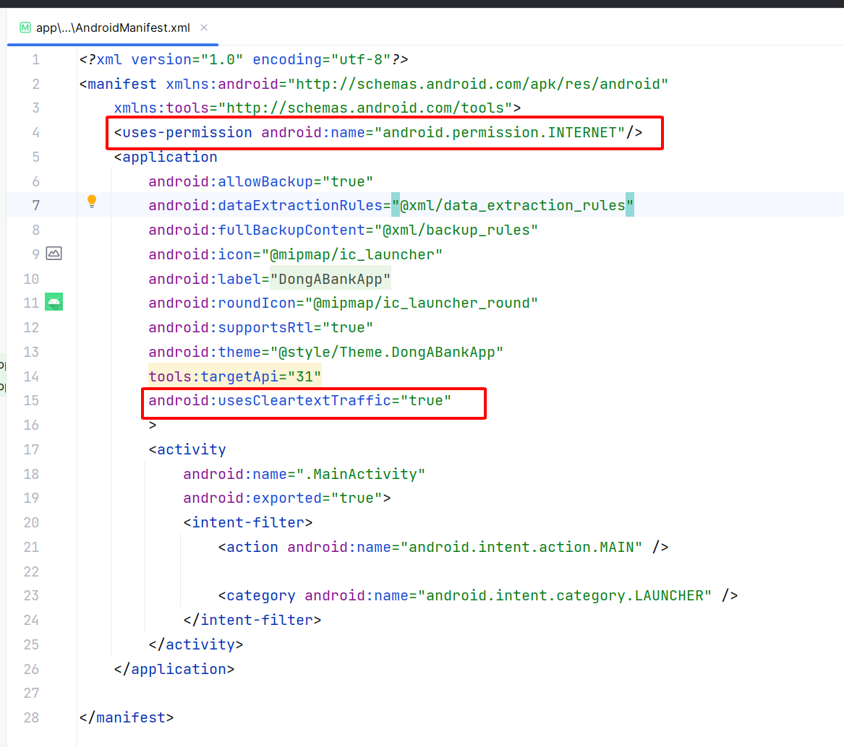
3. Integrating with DongA Bank
AndroidManifest

Slide 12
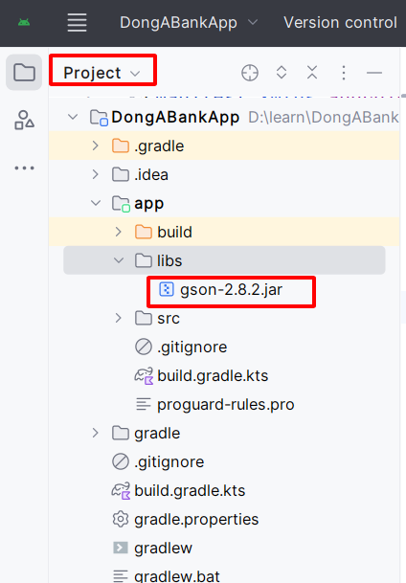
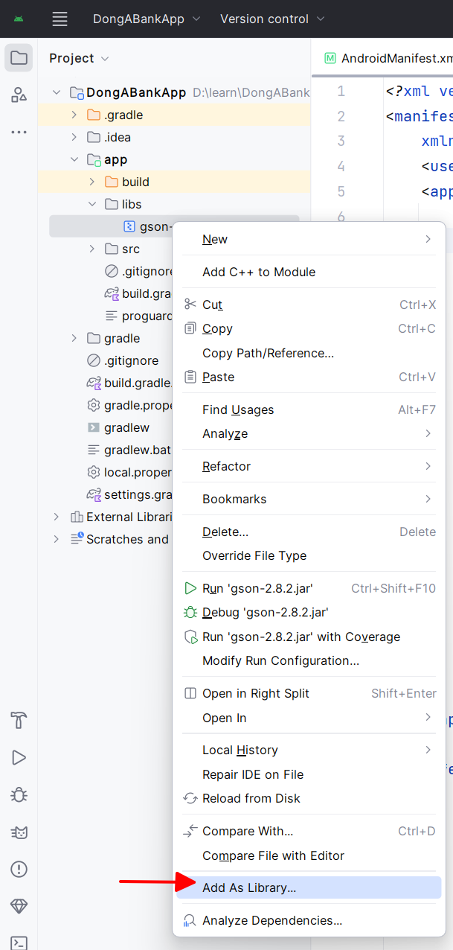
3. Integrating with DongA Bank
Add GSon
https://jar-download.com/artifacts/com.google.code.gson/gson/2.8.2/source-code
>=2.2.4 OK
Right click

Slide 13
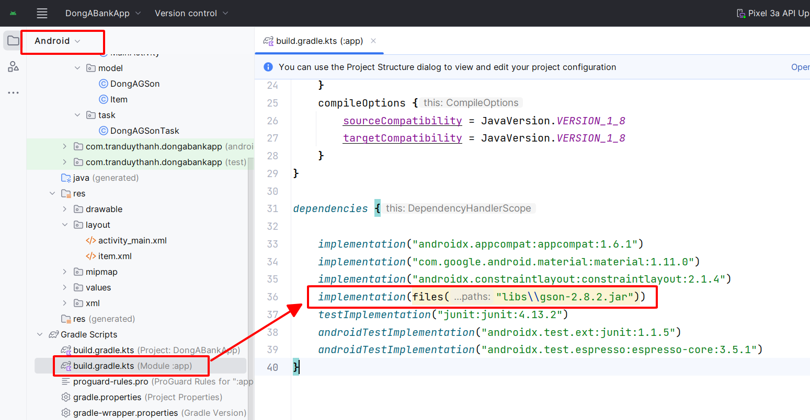
3. Integrating with DongA Bank
Add GSon
https://jar-download.com/artifacts/com.google.code.gson/gson/2.8.2/source-code
>=2.2.4 OK

Slide 14
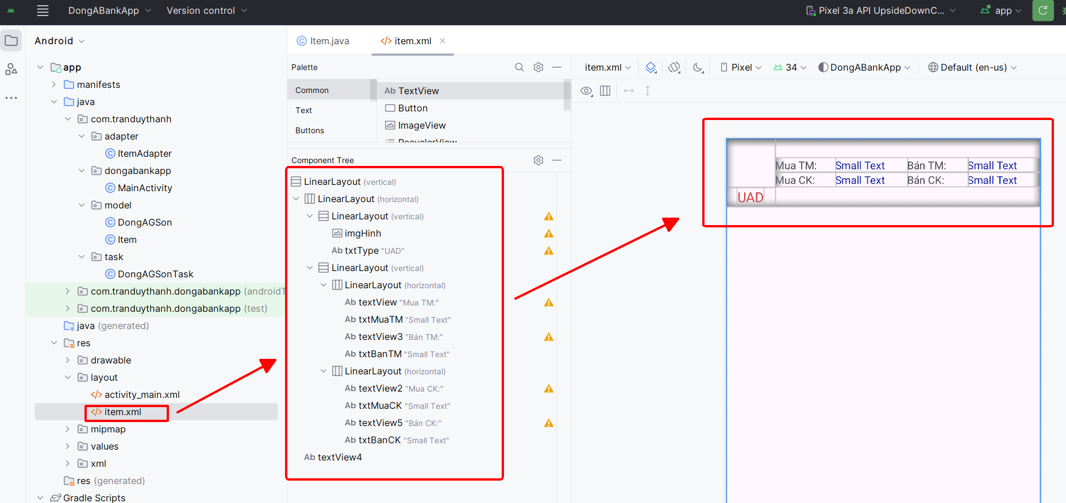
3. Integrating with DongA Bank

Slide 15
3. Integrating with DongA Bank
item.xml
<?xml version="1.0" encoding="utf-8"?> <LinearLayout xmlns:android="http://schemas.android.com/apk/res/android" android:orientation="vertical" android:layout_width="match_parent" android:layout_height="match_parent"> <LinearLayout android:orientation="horizontal" android:layout_width="match_parent" android:layout_height="wrap_content"> <LinearLayout android:orientation="vertical" android:layout_width="wrap_content" android:layout_height="match_parent"> <ImageView android:layout_width="64dp" android:layout_height="64dp" android:id="@+id/imgHinh" /> <TextView android:layout_width="wrap_content" android:layout_height="wrap_content" android:textAppearance="?android:attr/textAppearanceMedium" android:text="UAD" android:id="@+id/txtType" android:layout_gravity="center" android:textColor="#cf3838" /> </LinearLayout>

Slide 16
3. Integrating with DongA Bank
<LinearLayout android:orientation="vertical" android:layout_width="match_parent" android:layout_height="match_parent" android:gravity="center"> <LinearLayout android:orientation="horizontal" android:layout_width="match_parent" android:layout_height="wrap_content"> <TextView android:layout_weight="1" android:layout_width="50dp" android:layout_height="wrap_content" android:textAppearance="?android:attr/textAppearanceSmall" android:text="Mua TM:" android:id="@+id/textView" /> <TextView android:layout_weight="1" android:layout_width="wrap_content" android:layout_height="wrap_content" android:textAppearance="?android:attr/textAppearanceSmall" android:text="Small Text" android:id="@+id/txtMuaTM" android:textColor="#0b1c9c" /> <TextView android:layout_weight="1" android:layout_width="50dp" android:layout_height="wrap_content" android:textAppearance="?android:attr/textAppearanceSmall" android:text="Bán TM:" android:id="@+id/textView3" /> <TextView android:layout_weight="1" android:layout_width="wrap_content" android:layout_height="wrap_content" android:textAppearance="?android:attr/textAppearanceSmall" android:text="Small Text" android:id="@+id/txtBanTM" android:textColor="#0b1c9c" /> </LinearLayout>
item.xml

Slide 17
3. Integrating with DongA Bank
item.xml
<LinearLayout android:orientation="horizontal" android:layout_width="match_parent" android:layout_height="wrap_content"> <TextView android:layout_weight="1" android:layout_width="50dp" android:layout_height="wrap_content" android:textAppearance="?android:attr/textAppearanceSmall" android:text="Mua CK:" android:id="@+id/textView2" /> <TextView android:layout_weight="1" android:layout_width="wrap_content" android:layout_height="wrap_content" android:textAppearance="?android:attr/textAppearanceSmall" android:text="Small Text" android:id="@+id/txtMuaCK" android:textColor="#0b1c9c" /> <TextView android:layout_weight="1" android:layout_width="50dp" android:layout_height="wrap_content" android:textAppearance="?android:attr/textAppearanceSmall" android:text="Bán CK:" android:id="@+id/textView5" /> <TextView android:layout_weight="1" android:layout_width="wrap_content" android:layout_height="wrap_content" android:textAppearance="?android:attr/textAppearanceSmall" android:text="Small Text" android:id="@+id/txtBanCK" android:textColor="#0b1c9c" /> </LinearLayout> </LinearLayout> </LinearLayout> <TextView android:layout_width="match_parent" android:layout_height="wrap_content" android:textAppearance="?android:attr/textAppearanceLarge" android:id="@+id/textView4" android:background="#070755" android:height="1dp" /> </LinearLayout>

Slide 18
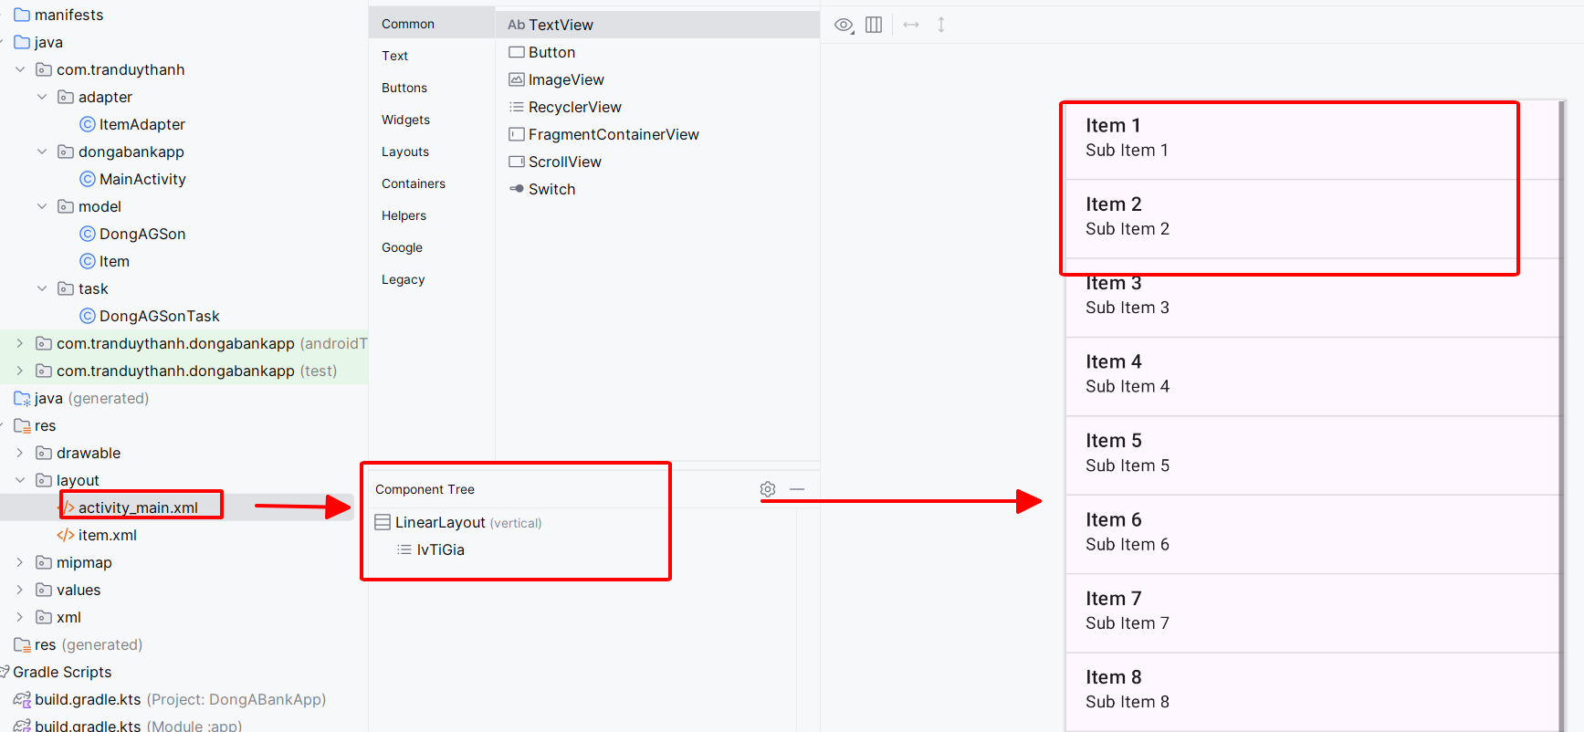
3. Integrating with DongA Bank
activity_main.xml

Slide 19
3. Integrating with DongA Bank
activity_main.xml
<?xml version="1.0" encoding="utf-8"?> <LinearLayout xmlns:android="http://schemas.android.com/apk/res/android" xmlns:app="http://schemas.android.com/apk/res-auto" xmlns:tools="http://schemas.android.com/tools" android:layout_width="match_parent" android:layout_height="match_parent" android:orientation="vertical" tools:context=".MainActivity"> <ListView android:layout_width="match_parent" android:layout_height="wrap_content" android:id="@+id/lvTiGia" /> </LinearLayout>

Slide 20
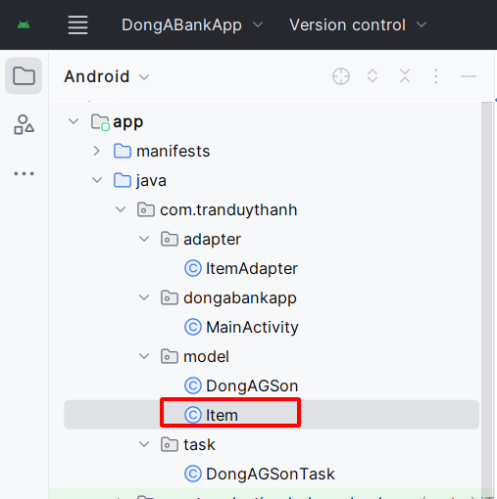
3. Integrating with DongA Bank
public class Item implements Serializable{ private String type; private String imageurl; private Bitmap hinh; private String muatienmat; private String muack; private String bantienmat; private String banck; public String getType() { return type; } public void setType(String type) { this.type = type; } public String getImageurl() { return imageurl; } public void setImageurl(String imageurl) { this.imageurl = imageurl; } public Bitmap getHinh() { return hinh; } public void setHinh(Bitmap hinh) { this.hinh = hinh; }

Slide 21
3. Integrating with DongA Bank
public String getMuatienmat() { return muatienmat; } public void setMuatienmat(String muatienmat) { this.muatienmat = muatienmat; } public String getMuack() { return muack; } public void setMuack(String muack) { this.muack = muack; } public String getBantienmat() { return bantienmat; } public void setBantienmat(String bantienmat) { this.bantienmat = bantienmat; } public String getBanck() { return banck; } public void setBanck(String banck) { this.banck = banck; } }

Slide 22
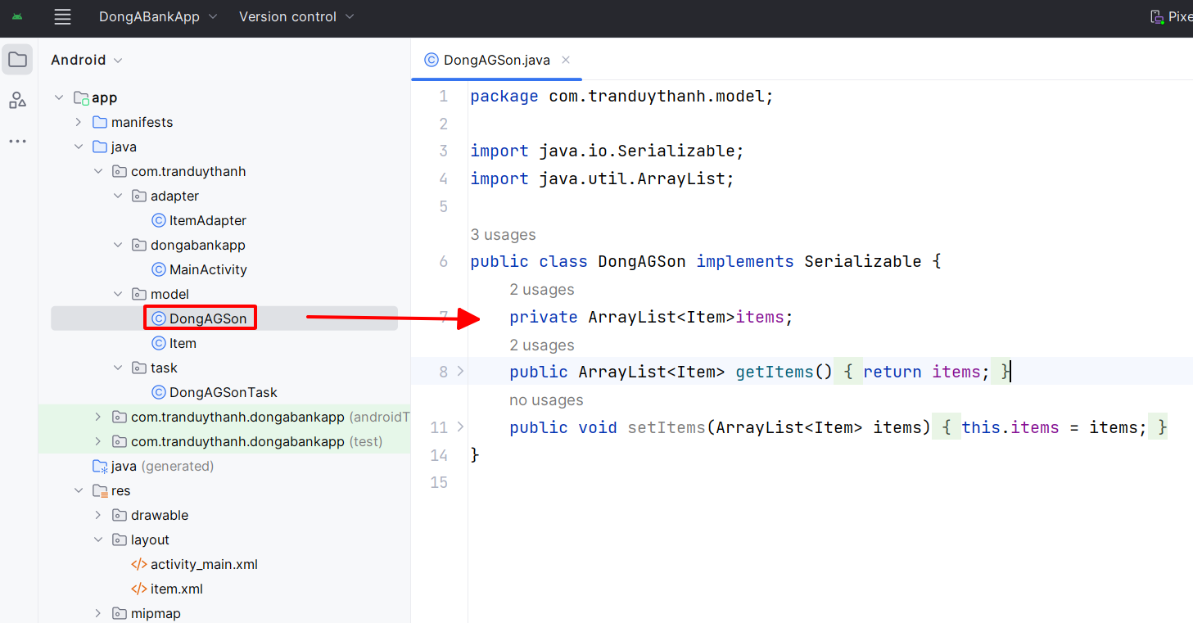
3. Integrating with DongA Bank

Slide 23
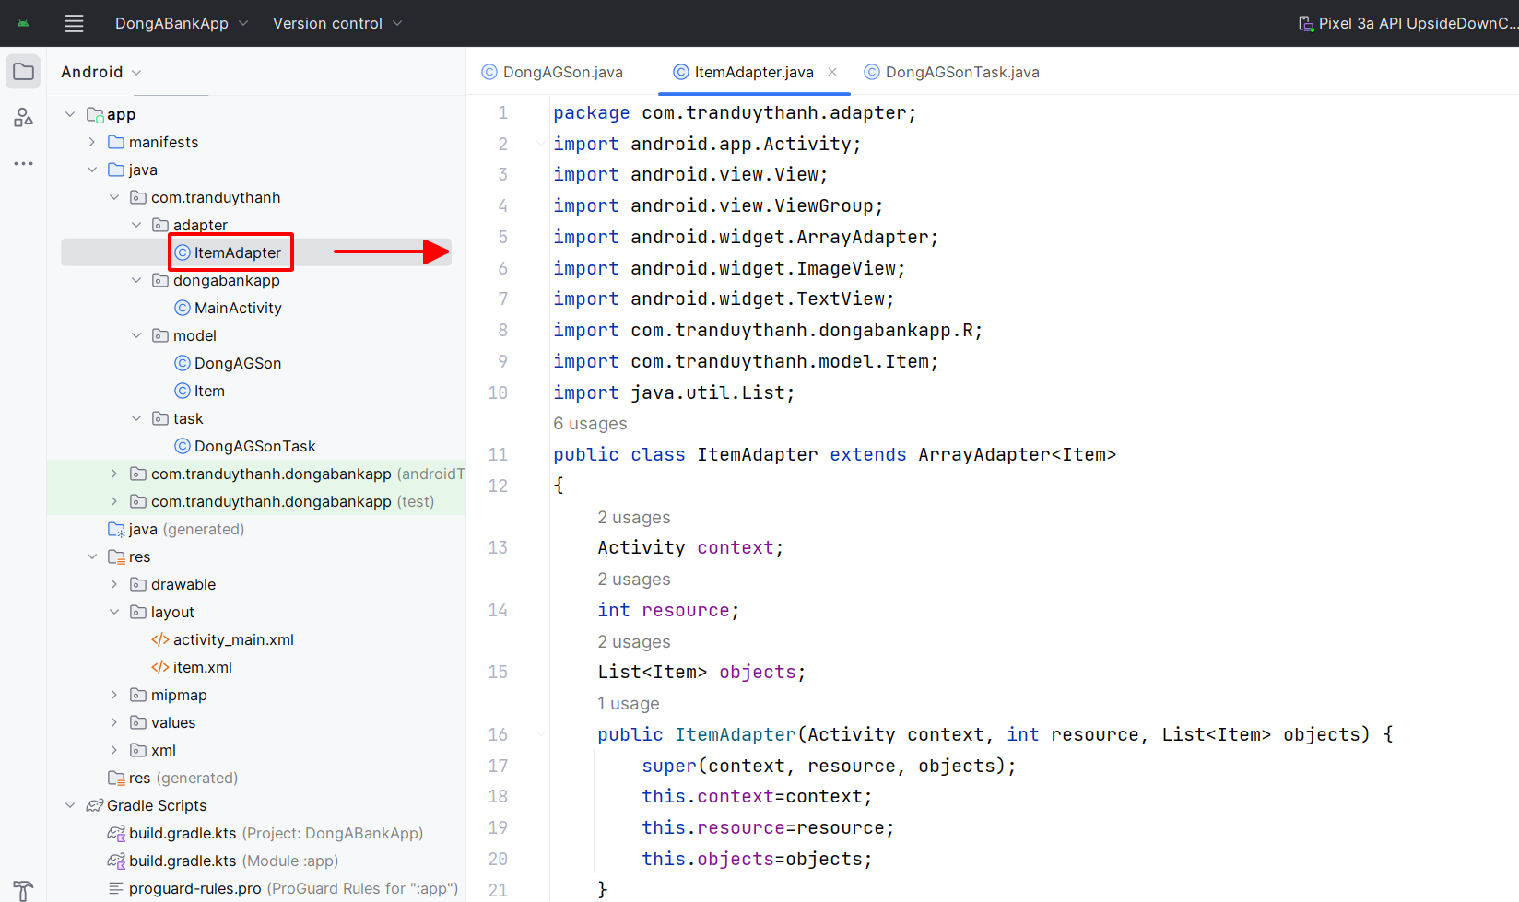
3. Integrating with DongA Bank

Slide 24
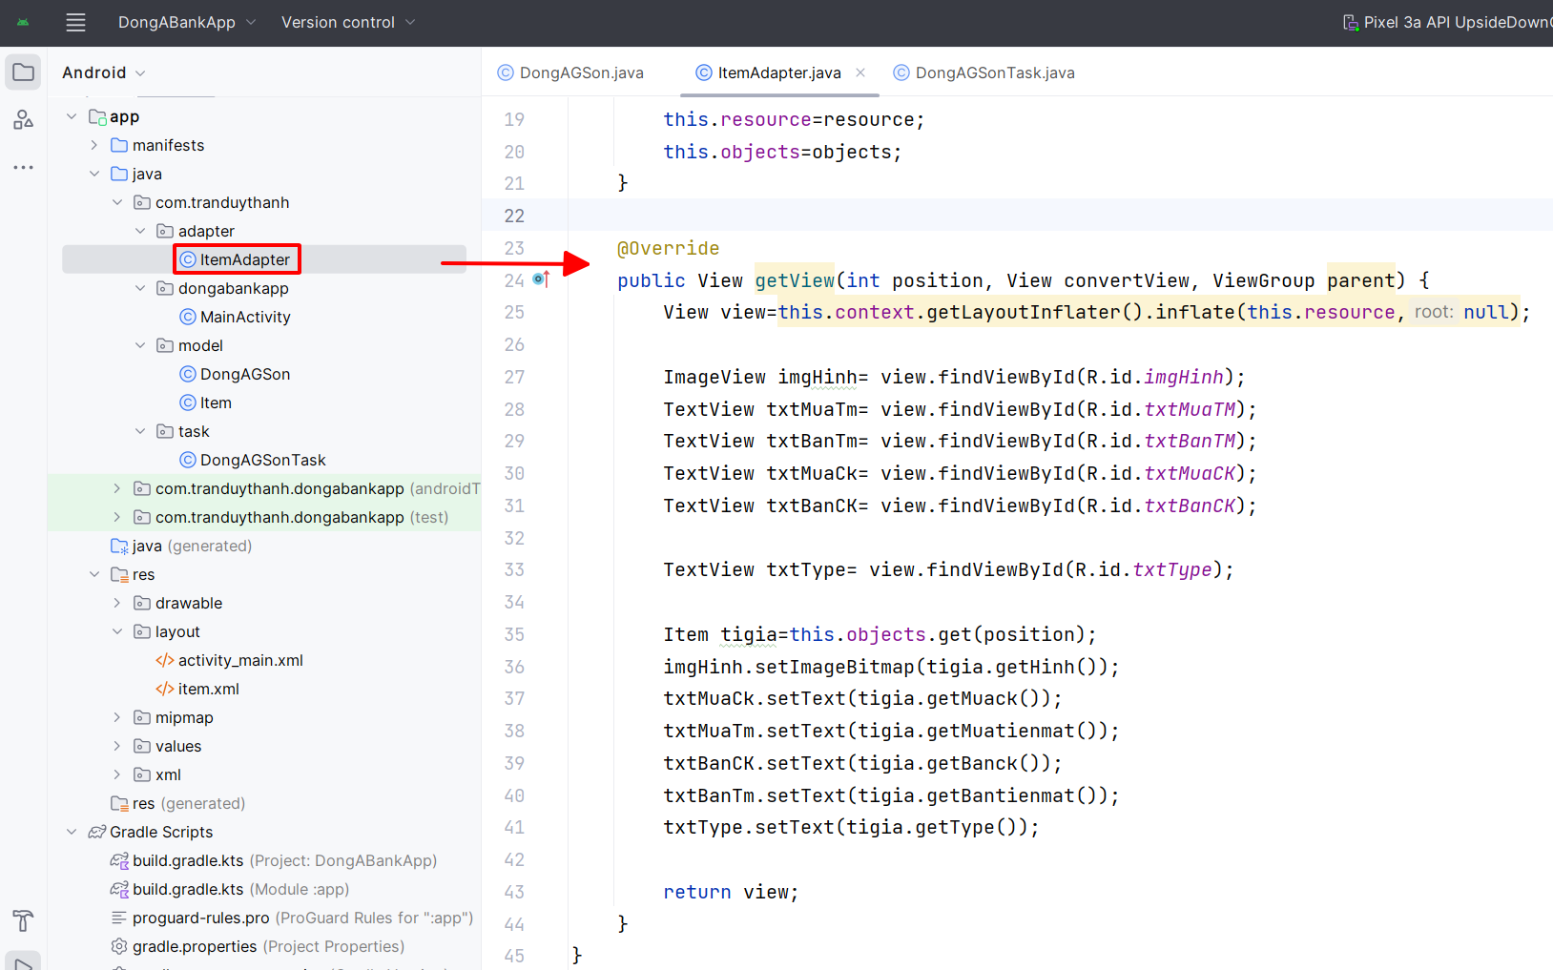
3. Integrating with DongA Bank

Slide 25
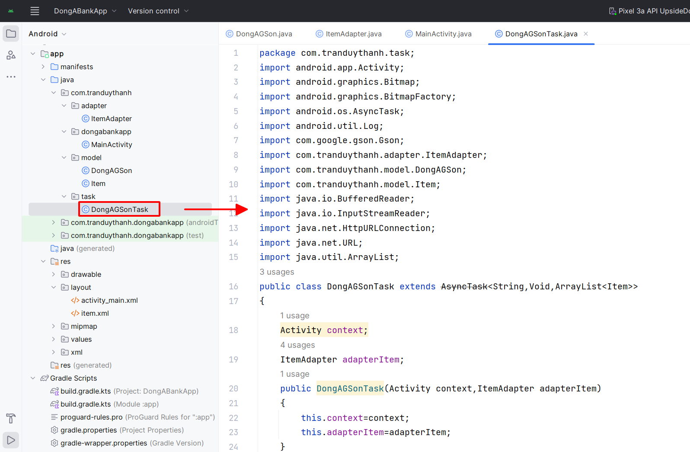
3. Integrating with DongA Bank

Slide 26
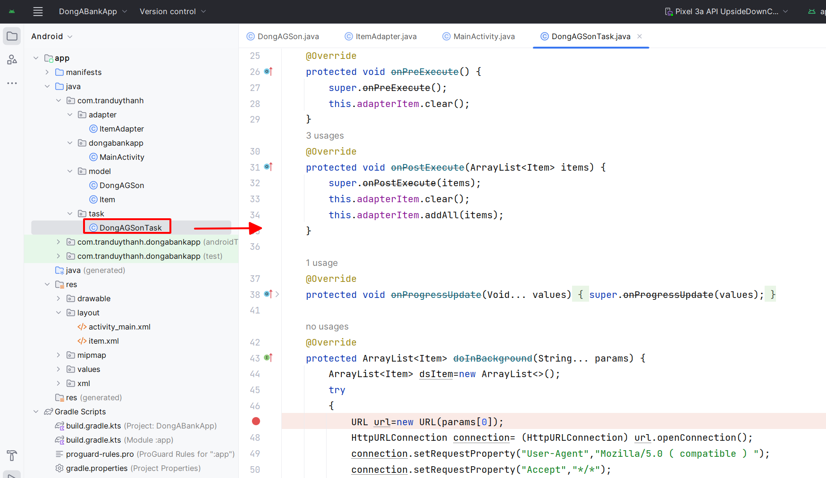
3. Integrating with DongA Bank

Slide 27
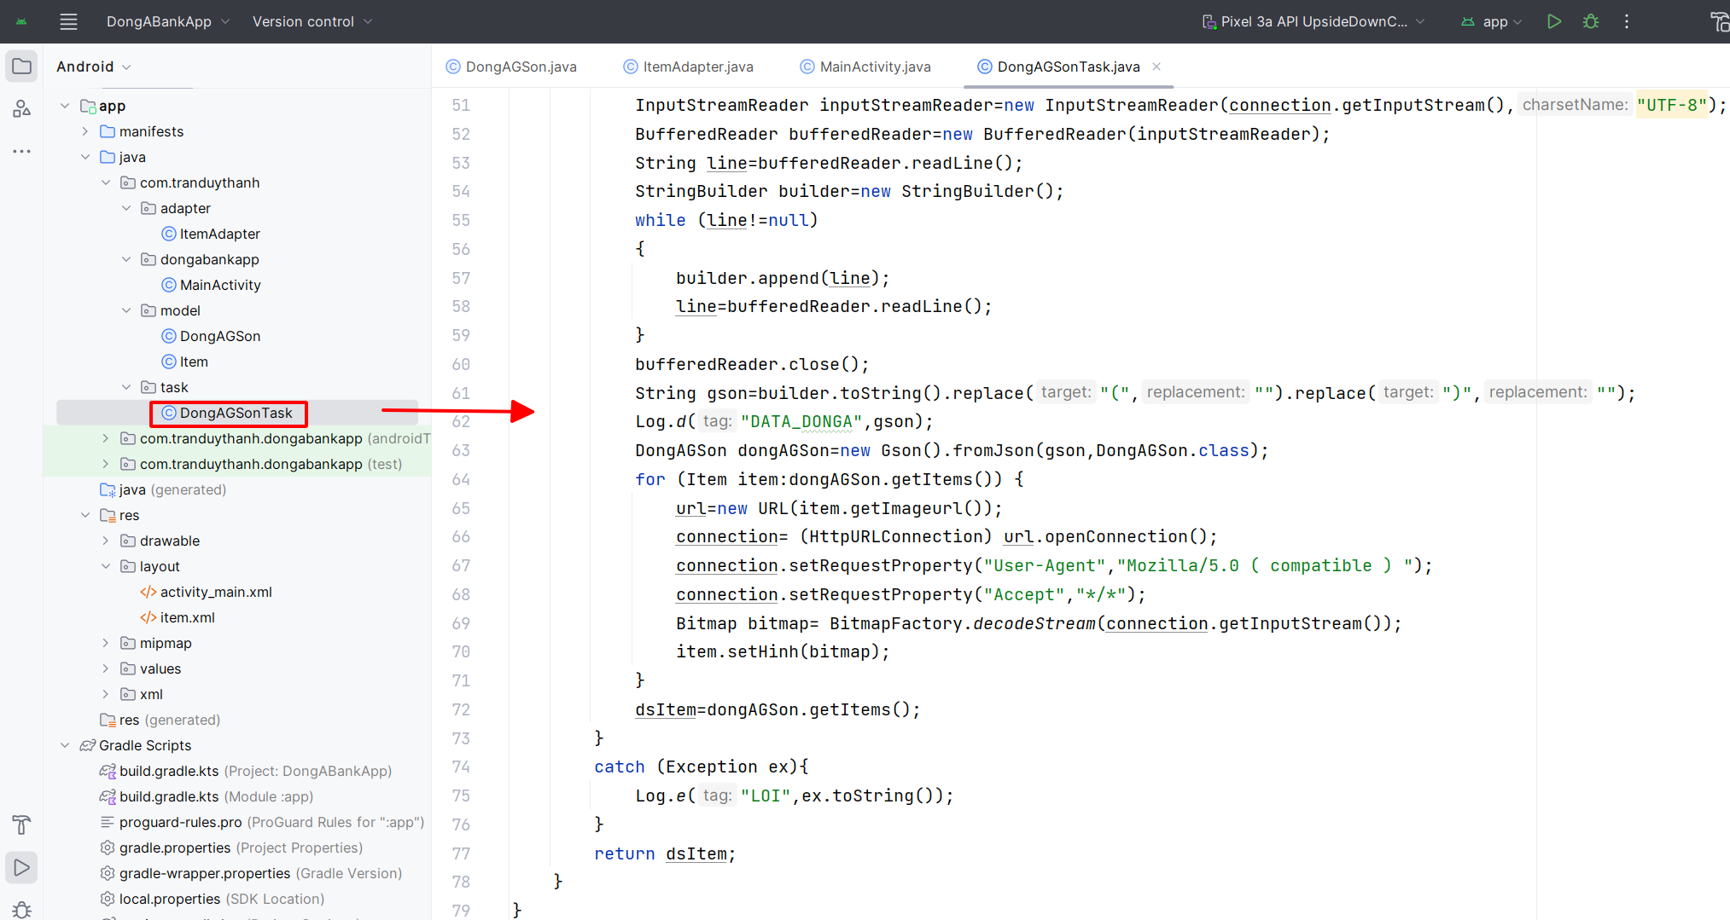
3. Integrating with DongA Bank

Slide 28
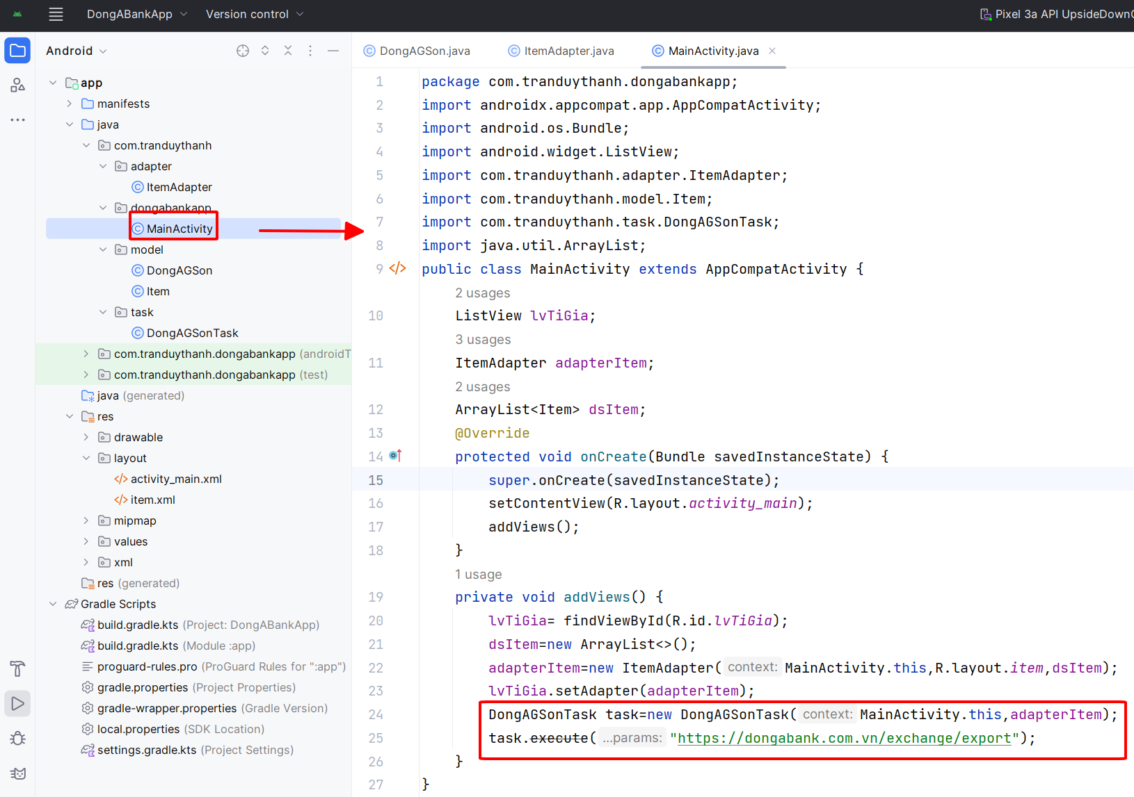
3. Integrating with DongA Bank

Slide 29
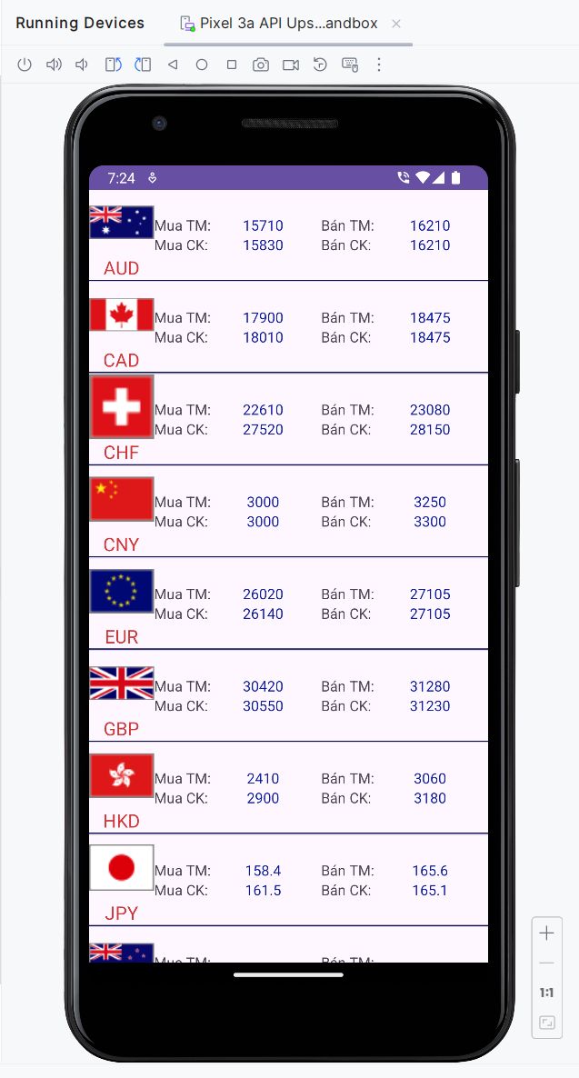
3. Integrating with DongA Bank

Slide 30
Discussions
Q1: What are advantages of Web Services?
Q2: What is RESTful API?
Q3: How to call a Web Service?
Q4: What are settings in Android Manifest for Web service connection?
Q5: How to use Multi-Threading for accessing Web Service?

Slide 31
Next Lesson
Google Services

Slide 32
THANK YOU!

